Slide 1
MOLE PREDICTOR
Bouazzaoui Mohammed
Junior Data Scientist at Becode

Slide 2
Content
Objective
Mission
Development
The app structure
Modelling
Demo / QA

Slide 3
Objective of this challenge
Repository: challenge-mole
Type of Challenge: Consolidation
Duration: 8 days
Deadline: 24/05/2022 4:30 (code)
Presentation: 25/05/2022 1:30 PM
Challenge: Solo

Slide 4
Mission
Create an MVP that will use a neural model to detect 7 types of moles.
Dataset used for modelling is :
https://www.kaggle.com/kmader/skin-cancer-mnist-ham10000

Slide 5
Development
Part 1 : create an interface application using python/flask
Part2 : create a model using autokeras
Deployment locally for the MVP, in the cloud for further versions

Slide 6
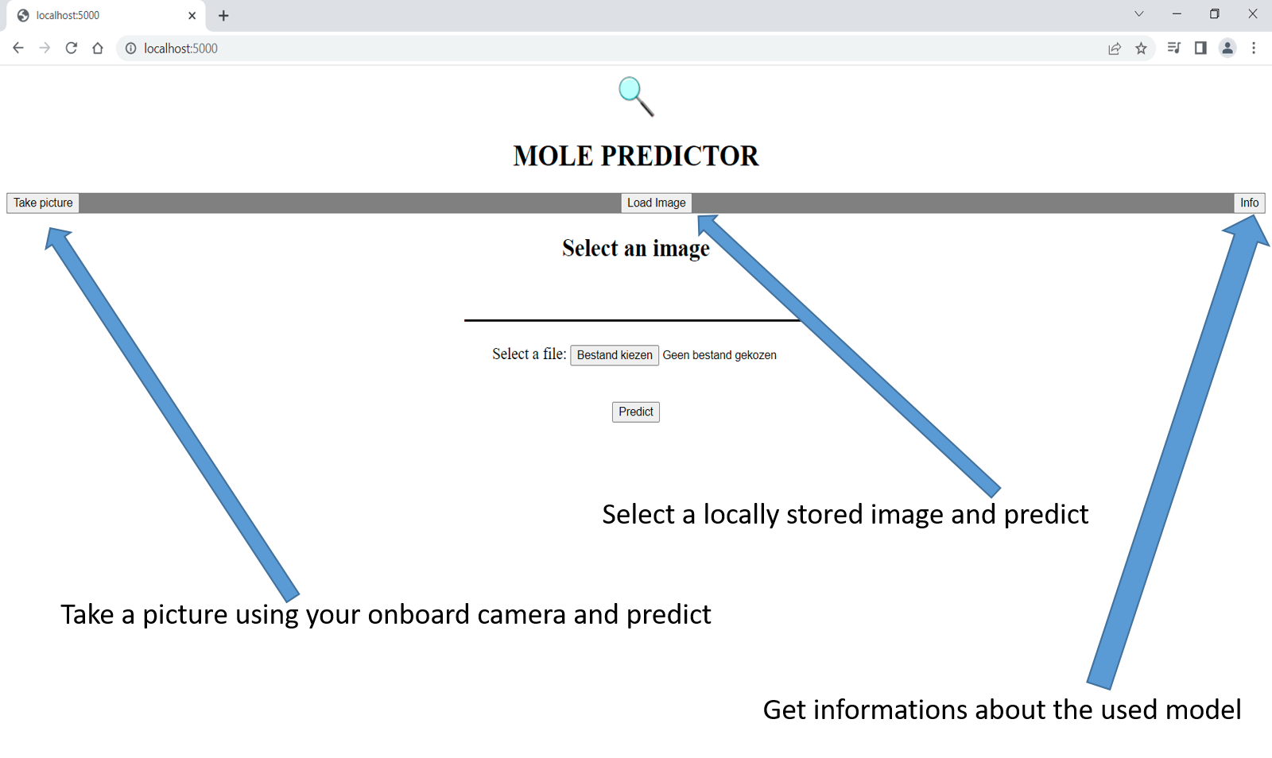
The app

Slide 7
The app : structure
App.py
Directories:
Notebook/ → molemodelling.ipynb
Pybin/ → images/
→ models/
→ templates/

Slide 8
Modelling
Autokeras
Image Classification
Image Regression
Text Classification
Text Regression
Structured Data Classification
Structured Data Regression
AutoModel :A Model defined by inputs and outputs.

Slide 9
Preparations
Analyze the dataset:
dataset is unbalanced
6705 images for 'nv':'Melanocytic nevi',
1113 images for 'mel':'Melanoma',
1099 images for 'bkl':'Benign keratosis-like lesions',
514 images for 'bcc':'Basal cell carcinoma',
327 images for 'akiec':'Actinic keratoses',
142 images for 'vas':'Vascular lesions',
115 images for 'df':'Dermatofibroma'
Use upsampling/downsampling
Use imagegenerator to create new images

Slide 10
Creating the model
Saving 10% of every class before any manipulation.
Create new images to balance the dataset (imagegenerator)
Every class more than 6000 images
Split 10% of augmented dataset for test/validation (5/5%) for best model
Let Keras select best model using ImageClassifier
Check 25 different models, each for 25 epochs
Train the best model using the remaining augmented dataset (train/test 70/30%)
Train for 10 epochs
Evaluate and save the model

Slide 11
The model autokeras/imageclassifier
input_1 (InputLayer) [(None, 64, 64, 3)] 0
cast_to_float32 (CastToFloat32) (None, 64, 64, 3) 0
normalization (Normalization) (None, 64, 64, 3) 7
conv2d (Conv2D) (None, 62, 62, 32) 896
conv2d_1 (Conv2D) (None, 60, 60, 64) 18496
max_pooling2d (MaxPooling2D) (None, 30, 30, 64) 0
dropout (Dropout) (None, 30, 30, 64) 0
conv2d_2 (Conv2D) (None, 28, 28, 64) 36928
conv2d_3 (Conv2D) (None, 26, 26, 512) 295424
max_pooling2d_1 (MaxPooling2D) (None, 13, 13, 512) 0
dropout_1 (Dropout) (None, 13, 13, 512) 0
conv2d_4 (Conv2D) (None, 11, 11, 32) 147488
conv2d_5 (Conv2D) (None, 9, 9, 32) 9248
max_pooling2d_2 (MaxPooling2D) (None, 4, 4, 32) 0
dropout_2 (Dropout) (None, 4, 4, 32) 0
flatten (Flatten) (None, 512) 0
dropout_3 (Dropout) (None, 512) 0
dense (Dense) (None, 7) 3591
classification_head_1 (Softmax) (None, 7) 0

Slide 12
Modelling results
Search best model:
Train
Epoch 25/25 81/81 [==============================] - 57s 704ms/step - loss: 0.9730 - accuracy: 0.6147
Evaluate
81/81 [==============================] - 14s 172ms/step - loss: 1.0991 - accuracy: 0.5842
Results for best model after training:
Train
Epoch 10/10 1020/1020 [==============================] - 721s 707ms/step - loss: 0.7839 - accuracy: 0.7024
Evaluate
437/437 [==============================] - 79s 181ms/step - loss: 0.7493 - accuracy: 0.7170

Slide 13
MOLE PREDICTOR
DEMO and Q/A
Contact:
linkedin.com/in/mbouazzaoui
mohammed.bouazzaoui@live.be

